Slide 1
SICOB MEETS YOUNG IFSO
ENDOBARIATRIC TREATMENT IN EUROPE: WHERE DO WE STAND?
PD Dr. med. habil. Sonja Chiappetta
Head of the Department of General Surgery
Ospedale Evangelico Betania, Naples, Italy
Center of Excellence Bariatric and Metabolic Surgery

Slide 2
Disclosure Slide
I have the following potential conflict of interest to report
Receipt of consultation fees:
Johnson & Johnson America (2021,2024)
Novo Nordisc (2021)
Innovamedica (2025-2026)
Genesis Medtech (USA) (2023)
Boston Scientific (2024-2026)
Ab Medica (2025)
Teleflex (2026)
Principal Investigator: MagDI Italy and MagCR Study, GT Metabolics^{TM;}
Course Director: Become a Metabolic Bariatric Surgeon, Naples, Italy
President Young IFSO 2026-2028

Slide 3

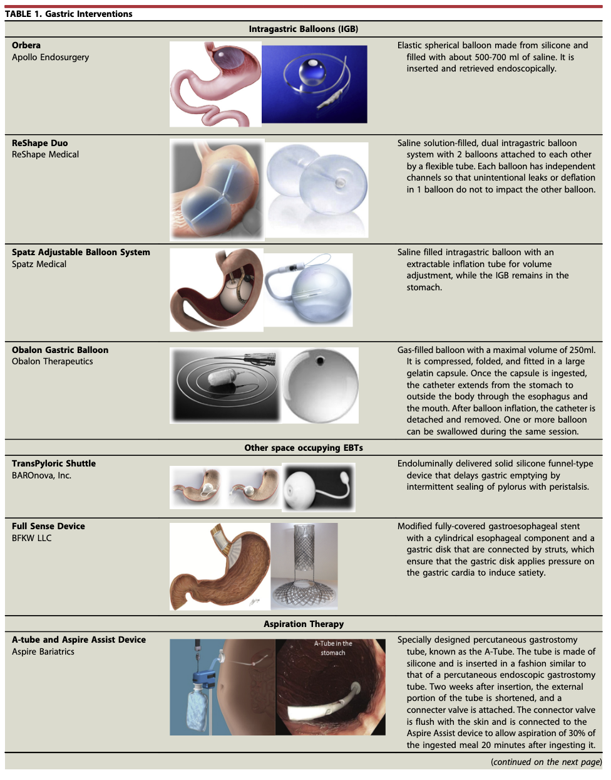
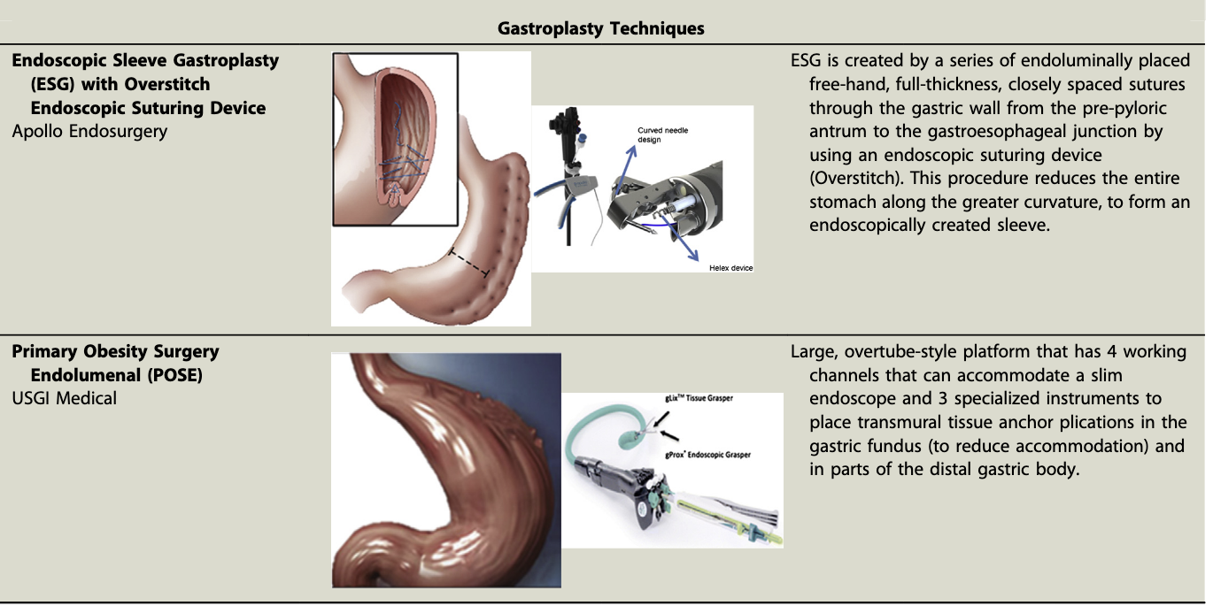
The Gastric-Volume-Reducing Effect
2015

Slide 4
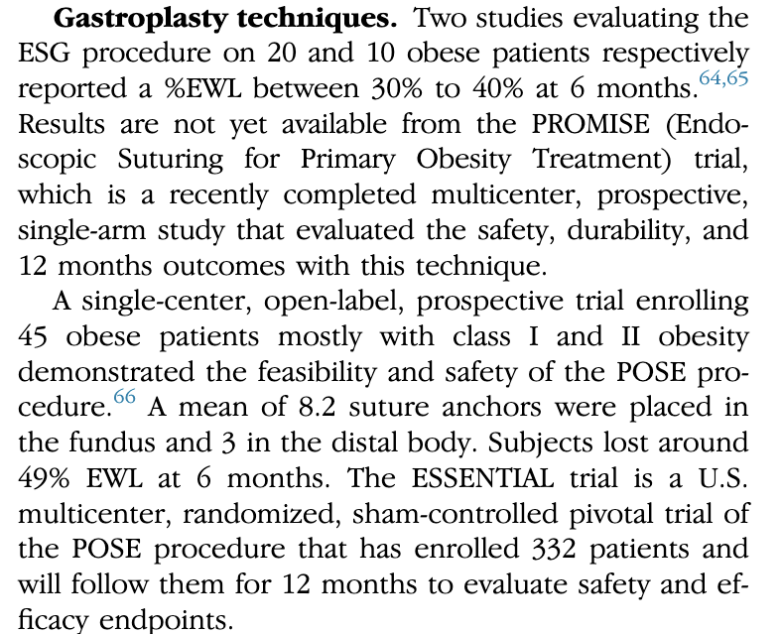
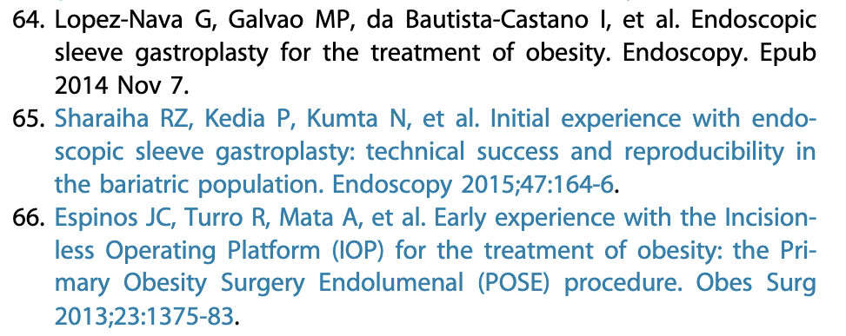
The Gastric-Volume-Reducing Effect
2015
2015: n = 30 ESG, n = 45 POSE

Slide 5
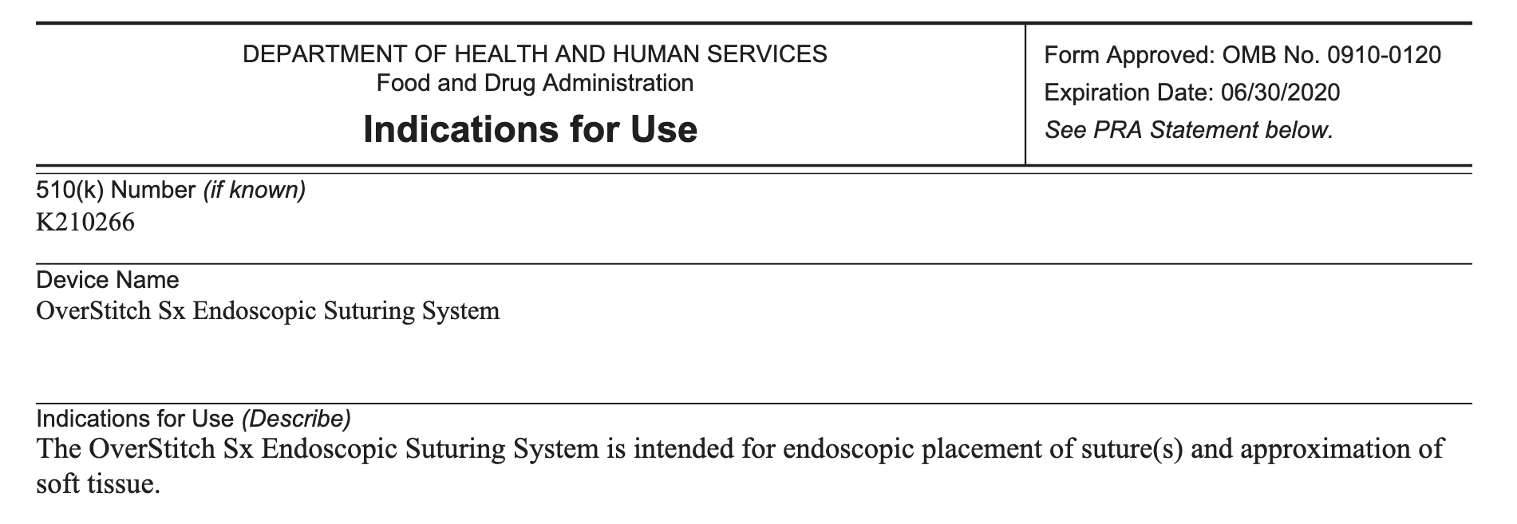
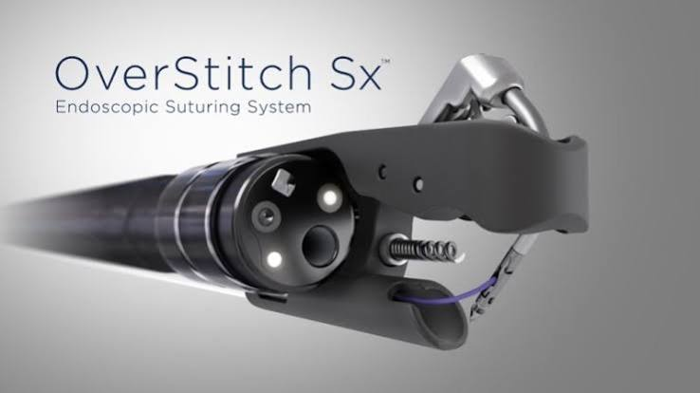
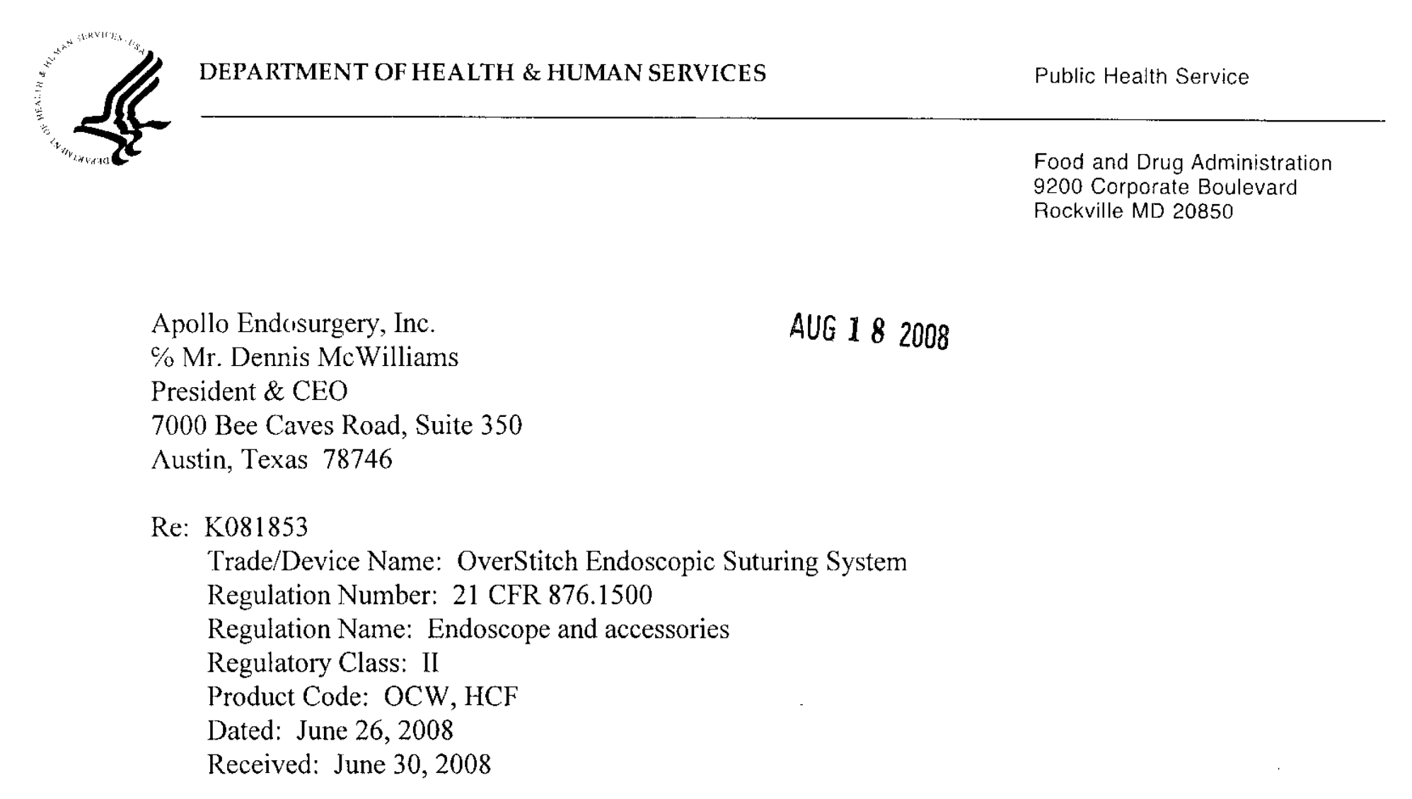
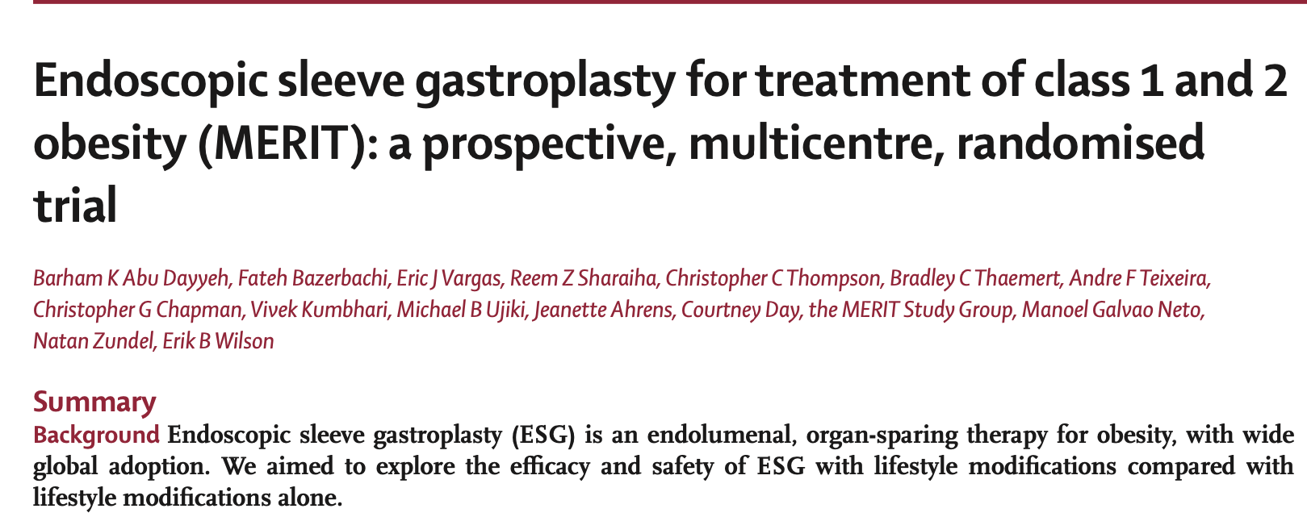
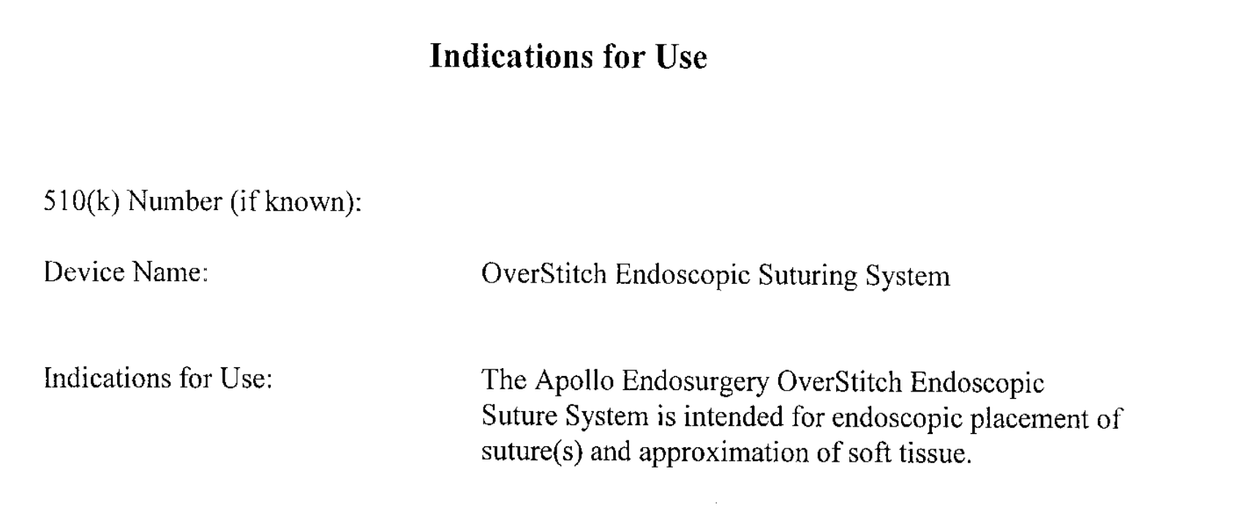
FDA Approval
single-channel diagnostic endoscopes
30.06.2020
Published July 28, 2022
Dec 2017- Jun 2019
n = 209: ESG (n=85) or to control (n=124)
After 52 weeks: Intervention vs Control
EWL: 49.2% versus 3.2% p<0.0001
TBWL 13.6% versus 0.8% p<0.0001
SAE ESG-related 2% (3/131)
No mortality
double-channel therapeutic scopes

Slide 6
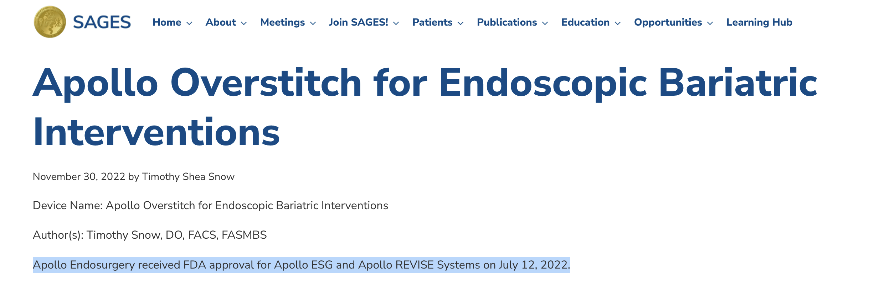
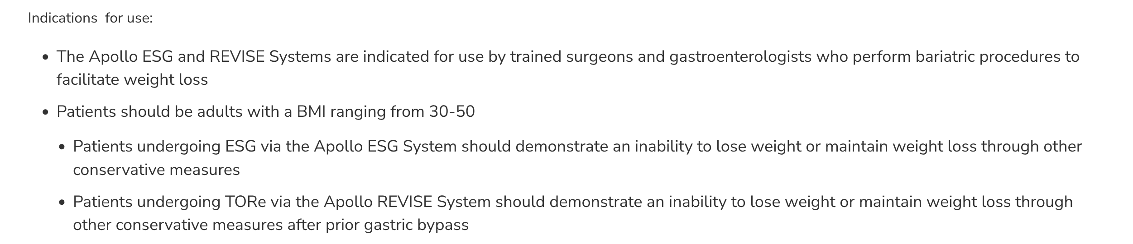
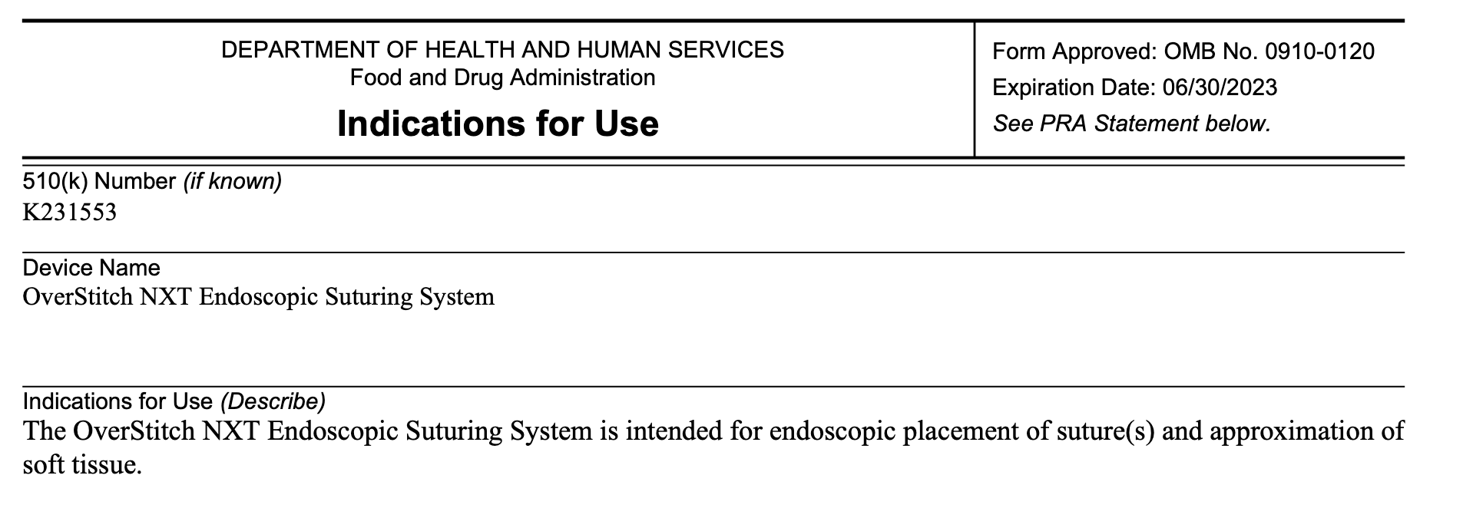
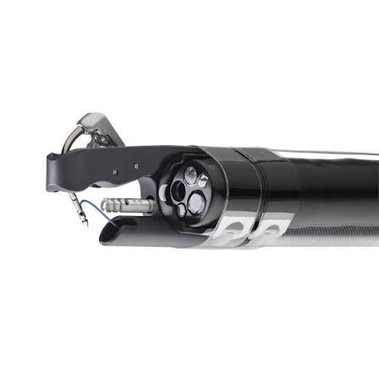
FDA Approval
single-channel diagnostic endoscopes
30.06.2020
12.07.2022
30.06.2023
double-channel therapeutic scopes

Slide 7
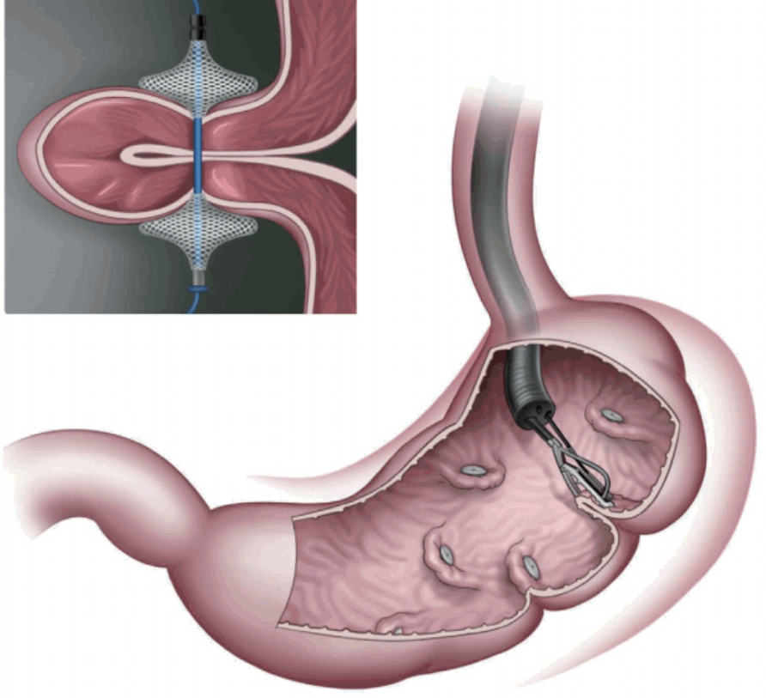
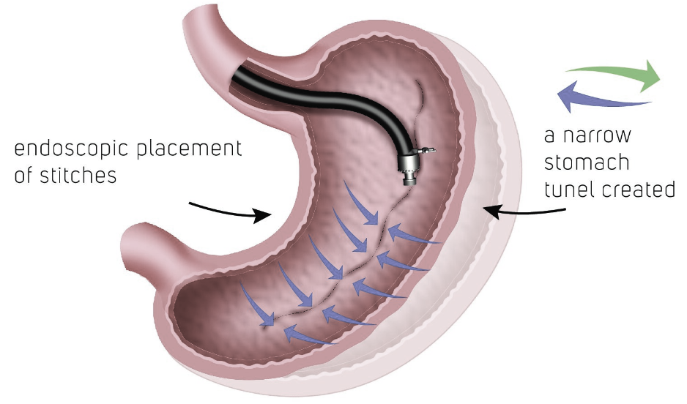
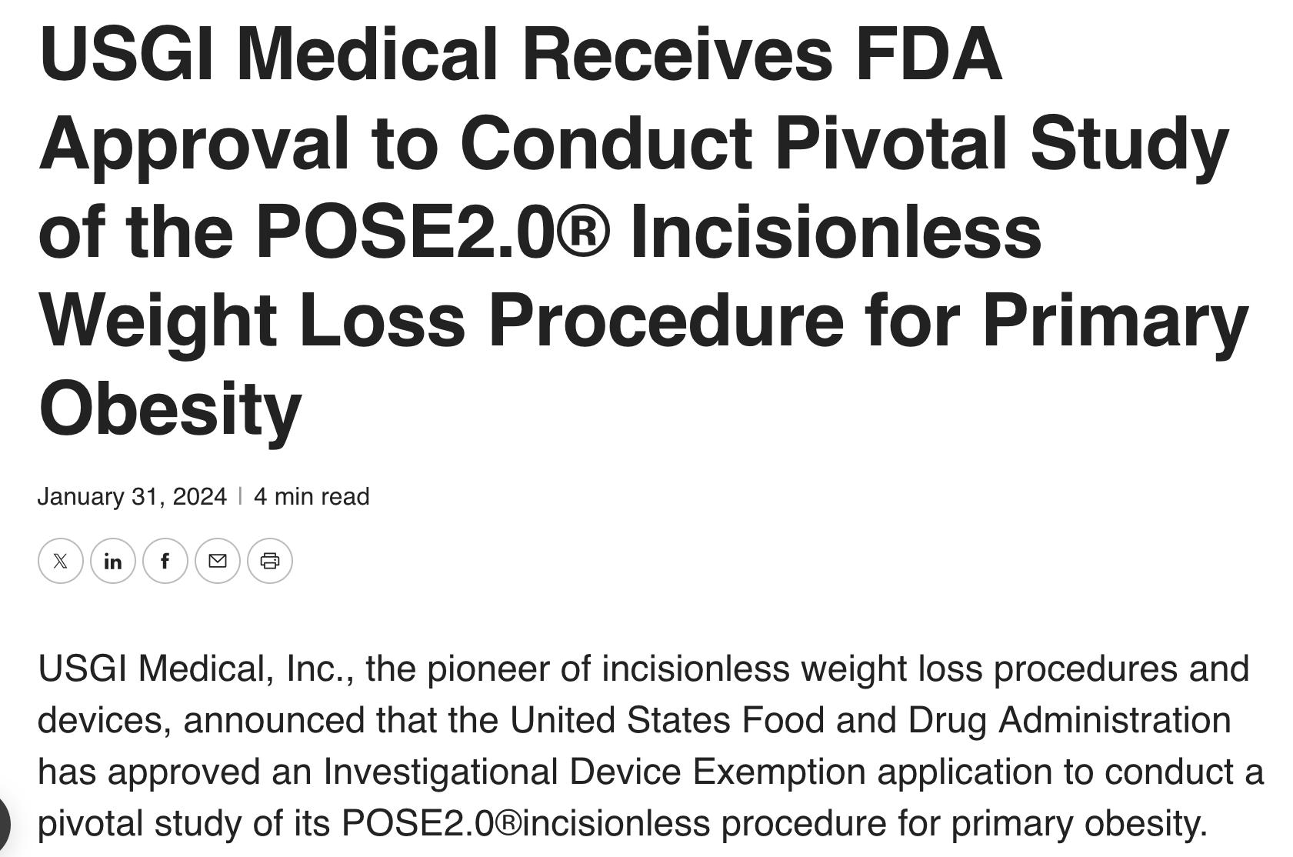
ESG
ENDOSCOPIC SLEEVE GASTROPLASTY
POSE
PRIMARY OBESITY SURGERY ENDOLUMINAL
U-SHAPES RUNNING SUTURING LINES IN THE CORPUS (DEPOT) OF THE STOMACH
THE FUNDUS IS SPARED
THE ANGLE OF HIS IS PRESERVED
A ‚PSEUDO-POUCH IS CRATED
SINGLE HELIX TECHNIQUE: 16 SUTURES
DOUBLE HELIX TECHNIQUE: 5-8 SUTURES
THE CORPUS OF THE STOMACH IS REMODELLED ANDSLEEVE-LIKE SHAPED
TBWL
13.6%
TBWL
15.7%
FDA APPROVEL 12.07.2022
ACUTALLY ONGOING PIVOTAL STUDY
FOR FDA APPROVAL
Abu Dayyeh et al; MERIT Study Group. Endoscopic sleeve gastroplasty for treatment of class 1 and 2 obesity (MERIT): a prospective,multicentre randomised trial. Lancet. 2022 Aug
Lopez Nava et al. Prospective Multicenter Study of the Primary Obesity Surgery Endoluminal (POSE 2.0) Procedure for Treatment of Obesity. Clin Gastroenterol Hepatol. 2023 Jan;21(1):81-89.e4.

Slide 8
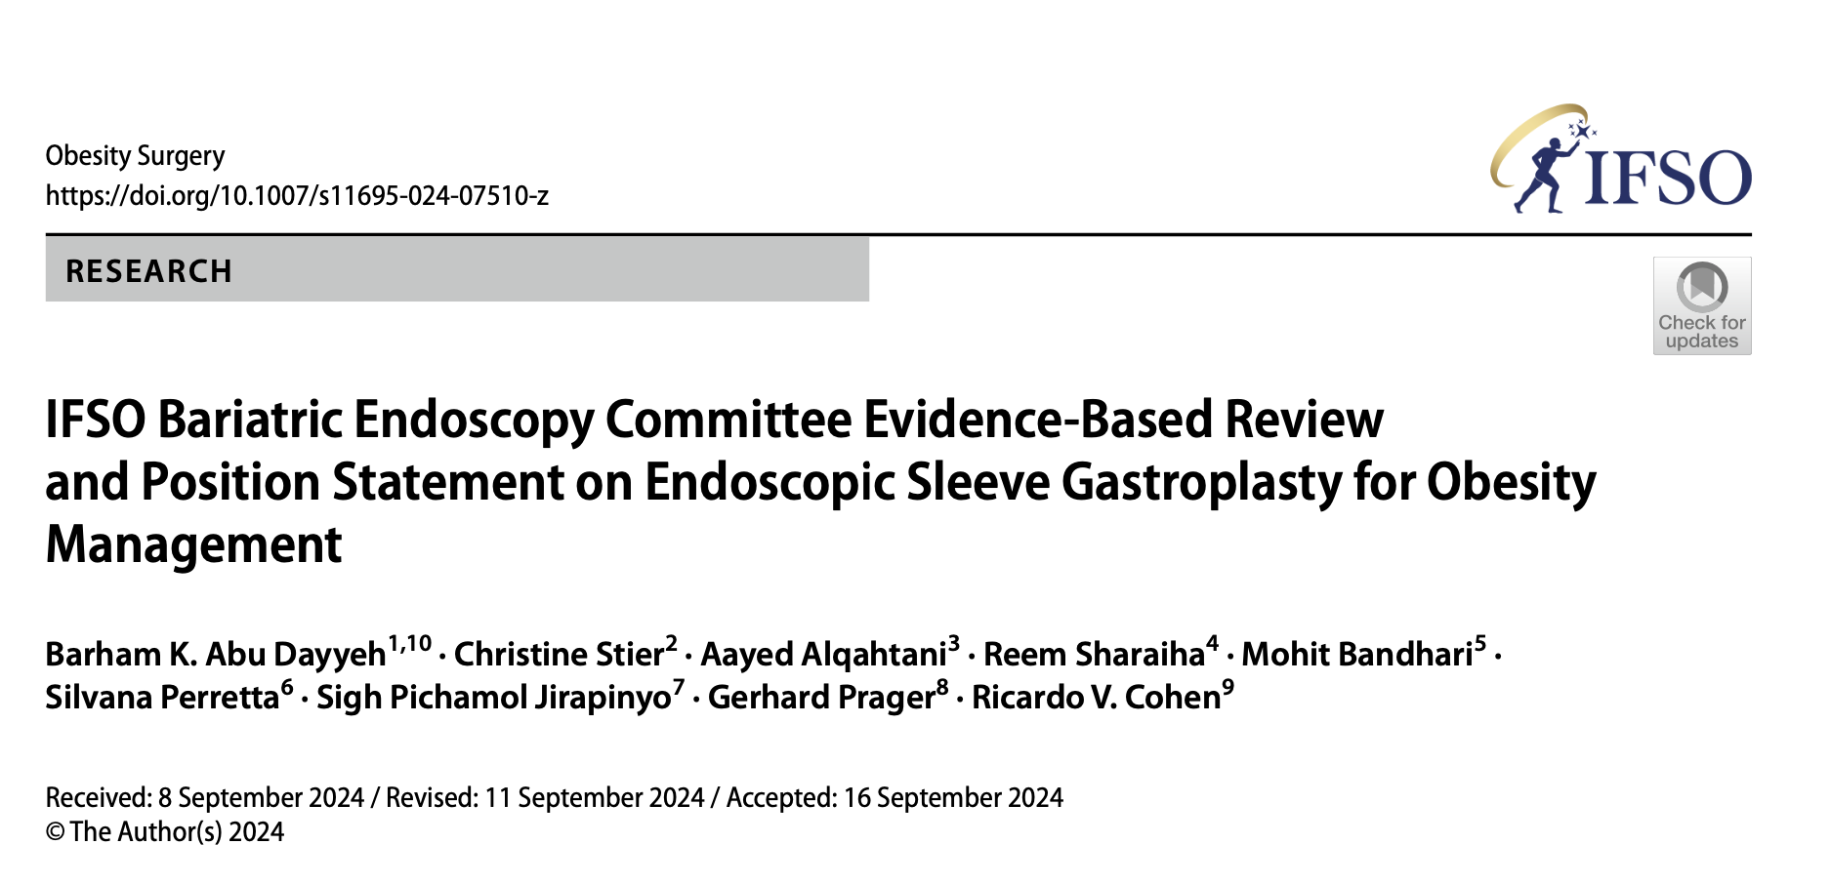
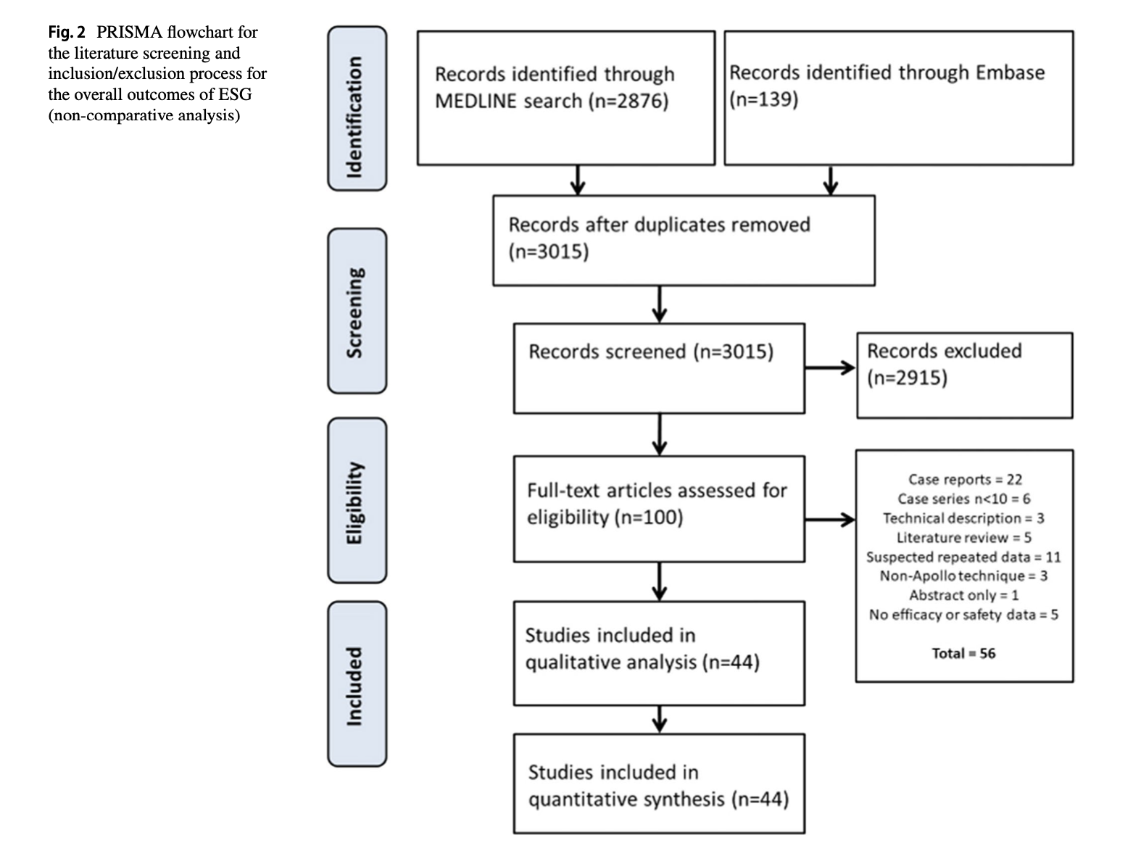
IFSO-ENDORSEMENT ON ESG 2024
mean baseline BMI was 37.56 kg/m²
n = 15.714
Notes:
Vor über 2000 Jahren hat

Slide 9
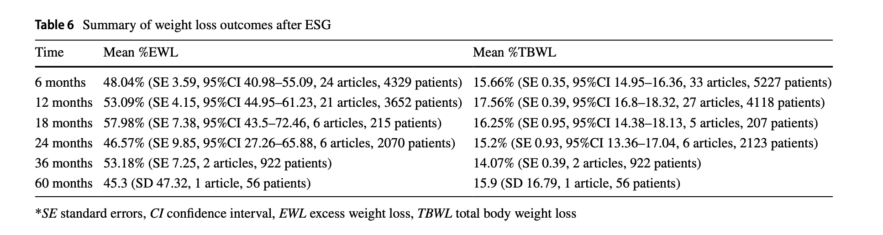
IFSO-ENDORSEMENT ON ESG 2024
Safety: The pooled serious adverse event rate was 1.25%.
This low rate of SAEs indicates that ESG is a relatively safe procedure.
Notes:
Vor über 2000 Jahren hat

Slide 10
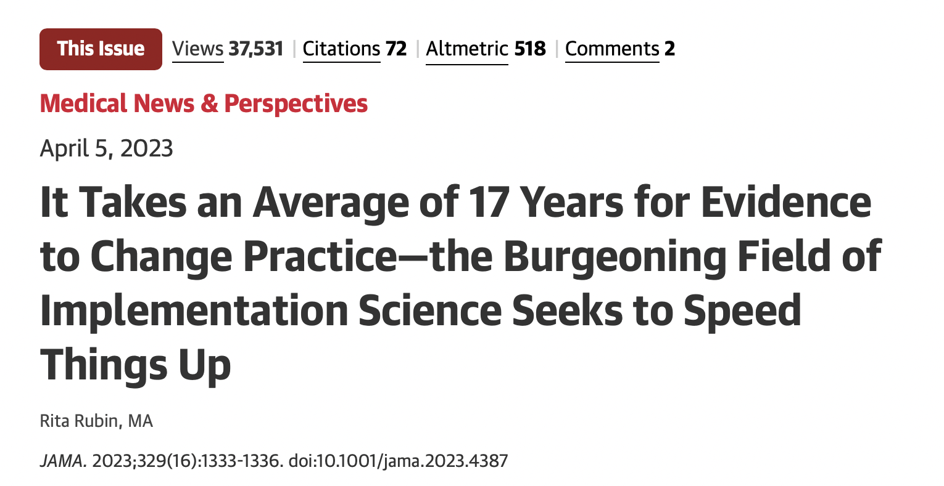
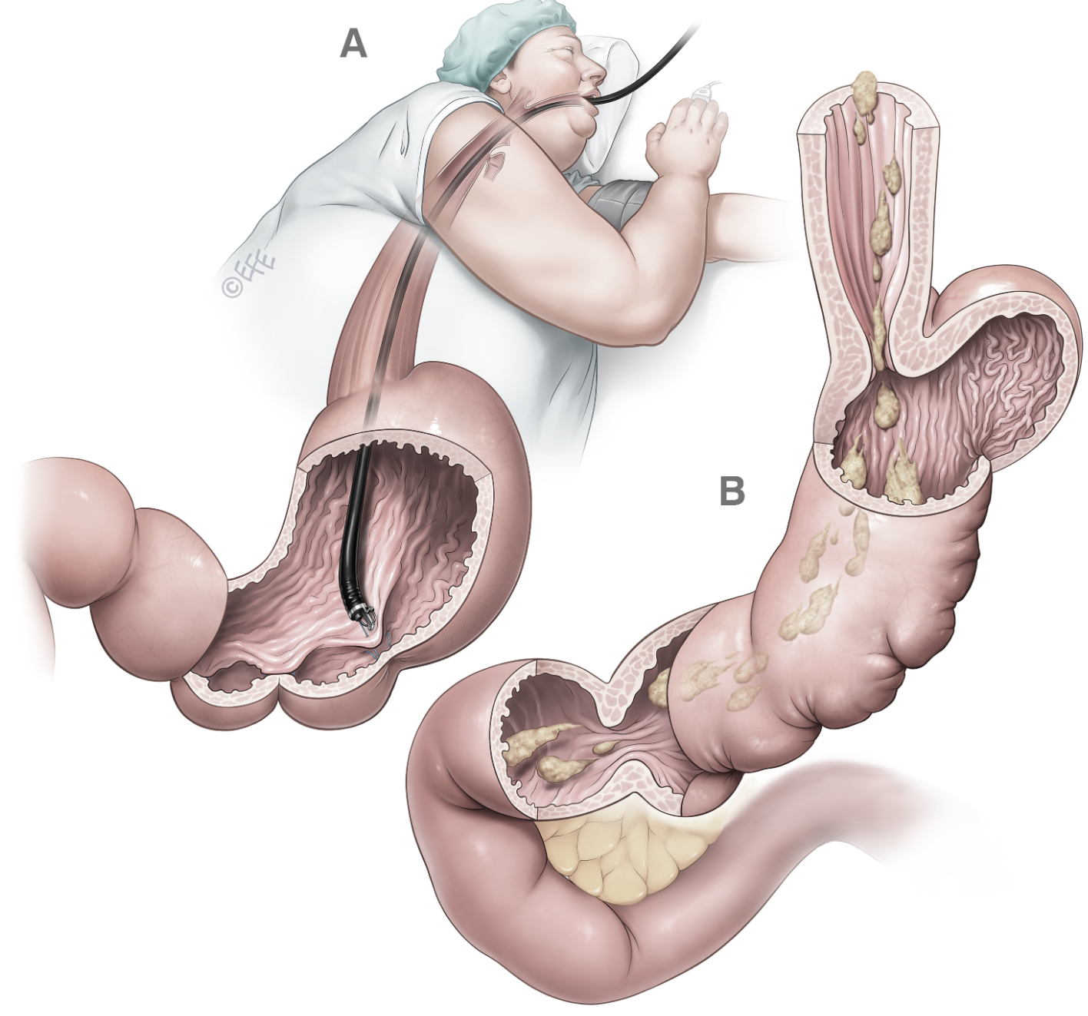
2008 → 2025
2017 around 3000 procedures
2009 around 10.000 procedures
2024/26 > 25.000 ESG procedures worldwide¹
From an innovative procedure to an established global obesity treatment within
approximately one decade!
1 Dayyeh BKA, Stier C, Alqahtani A, Sharaiha R, Bandhari M, Perretta S, Jirapinyo SP, Prager G, Cohen RV.
IFSO Bariatric Endoscopy Committee Evidence-Based Review and Position Statement on Endoscopic Sleeve Gastroplasty for Obesity Management.
Obes Surg. 2024 Dec;34(12):4318-4348. doi: 10.1007/s11695-024-07510-z

Slide 11

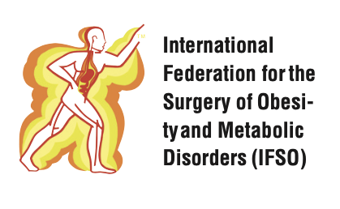

Treatment landscape of a chronic disease
Metabolic and Bariatric Surgery MBS - since 1994
TWL%: LSG: 24.9 % (23.6 to 26.2)
LRYGB: 28.1% (26.6 to 29.3) at 5 years
Salminen P et. al. Effect of Laparoscopic Sleeve Gastrectomy vs Laparoscopic
Roux-en-Y Gastric Bypass on Weight Loss at 5 Years Among Patients With Morbid Obesity:
The SLEEVEPASS Randomized Clinical Trial. JAMA. 2018 Jan 16;319(3):241-254..
Endoscopic Bariatric Therapy -EBT –
ESG since 07/2022
TWL 13-16% at 12 months
Abu Dayyeh BK, Bazerbachi F, Altayar O, et al. Endoscopic sleeve gastroplasty versus lifestyle modification for obesity: the MERIT randomized clinical trial. Lancet. 2022;400(10352):441–51.
Obesity Management Medications OMM - since 2014 (12/24 Liraglutide)
(Semaglutide (06/21) ~15% WL at 68–104wks)
Tirzepatide (11/23) (~16–22.5% WL at 72wks)
Oral Semaglutide 12/25
Wilding JPH, Batterham RL, Calanna S, et al. Once-weekly semaglutide in adults with overweight or obesity. N Engl J Med. 2021;384:989–1002.
Jastreboff AM, Aronne LJ, Ahmad NN, et al. Tirzepatide once weekly for the treatment of obesity. N Engl J Med. 2022;387:205–16.

Slide 12
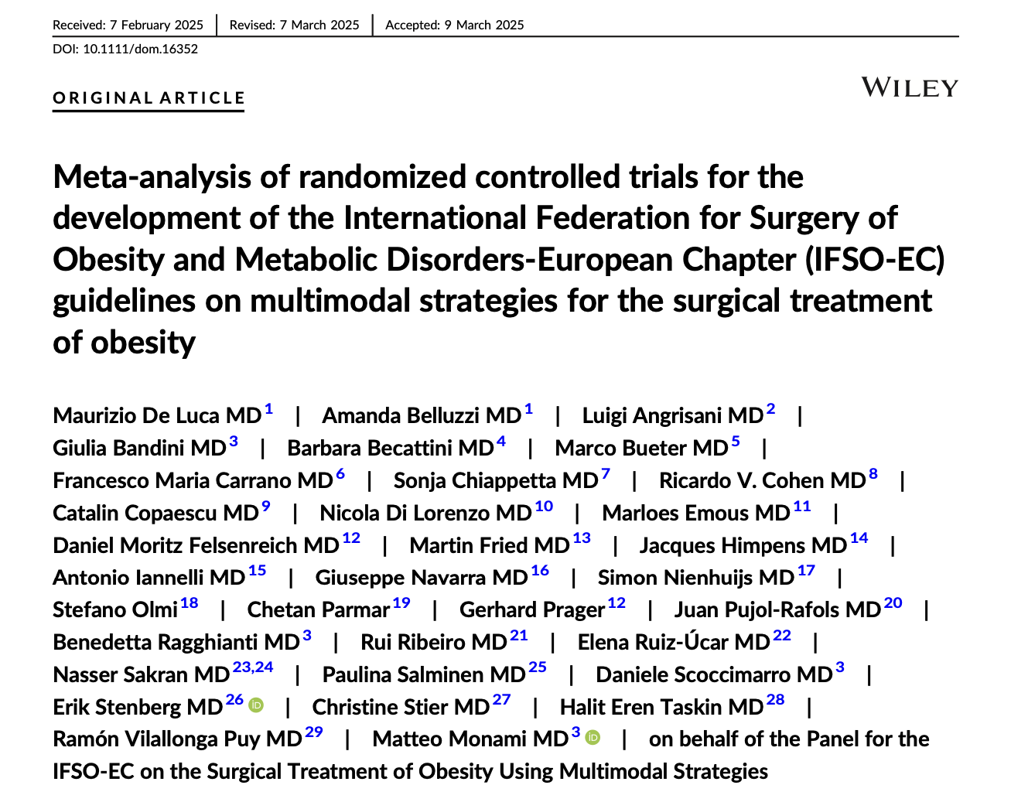
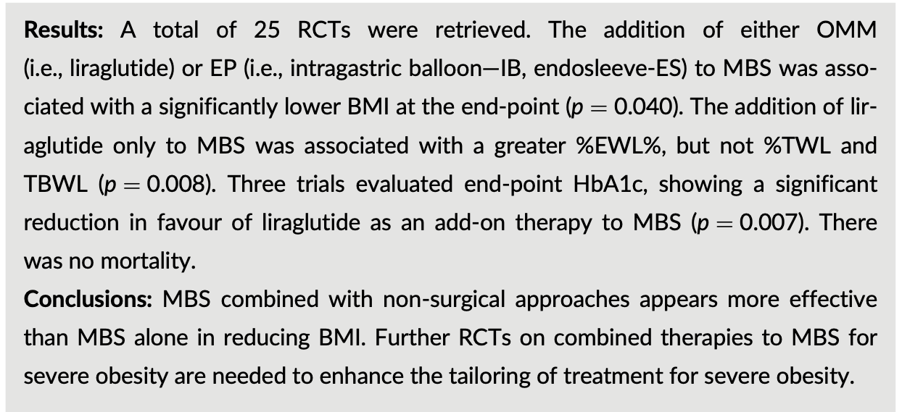
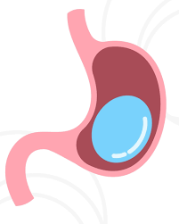
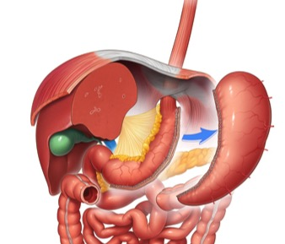
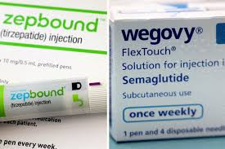

Multimodal Obesity Treatment
2025
+
+
=

Slide 13
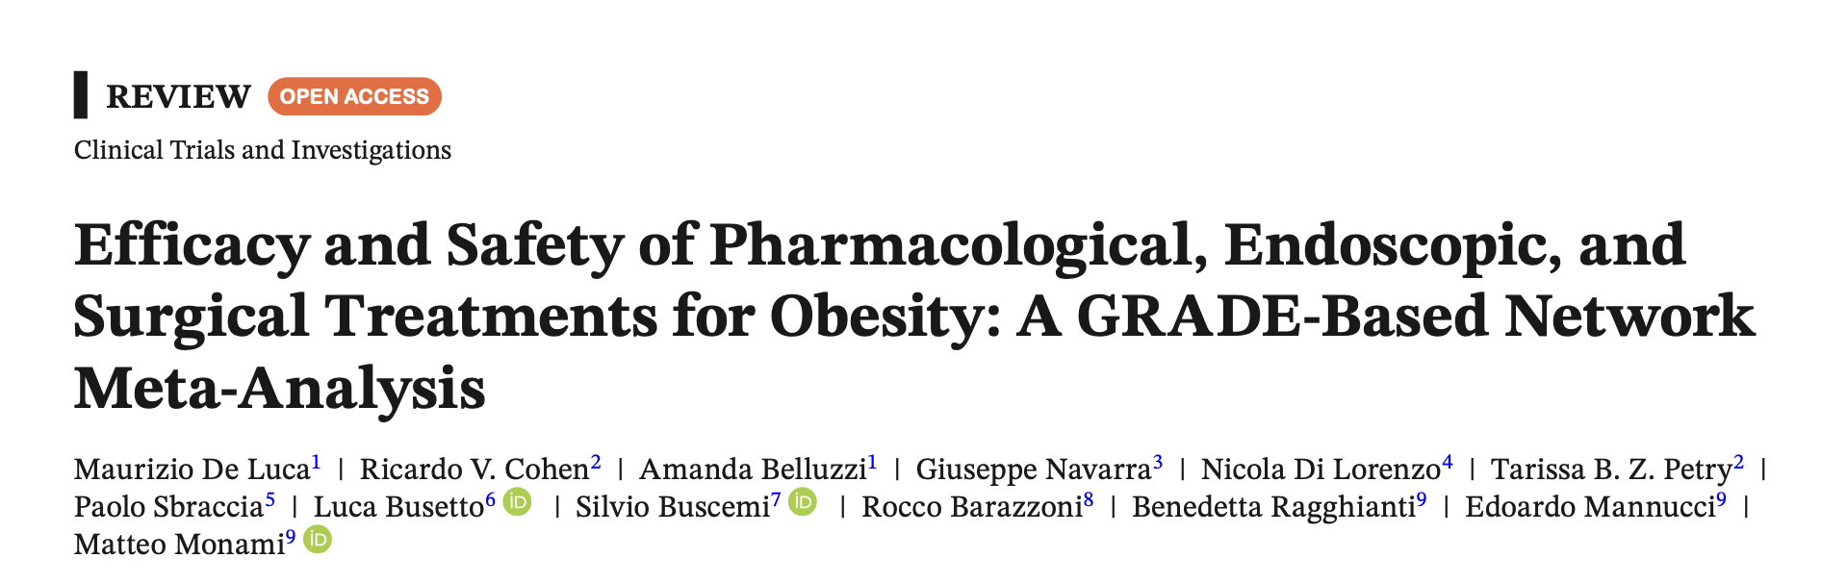
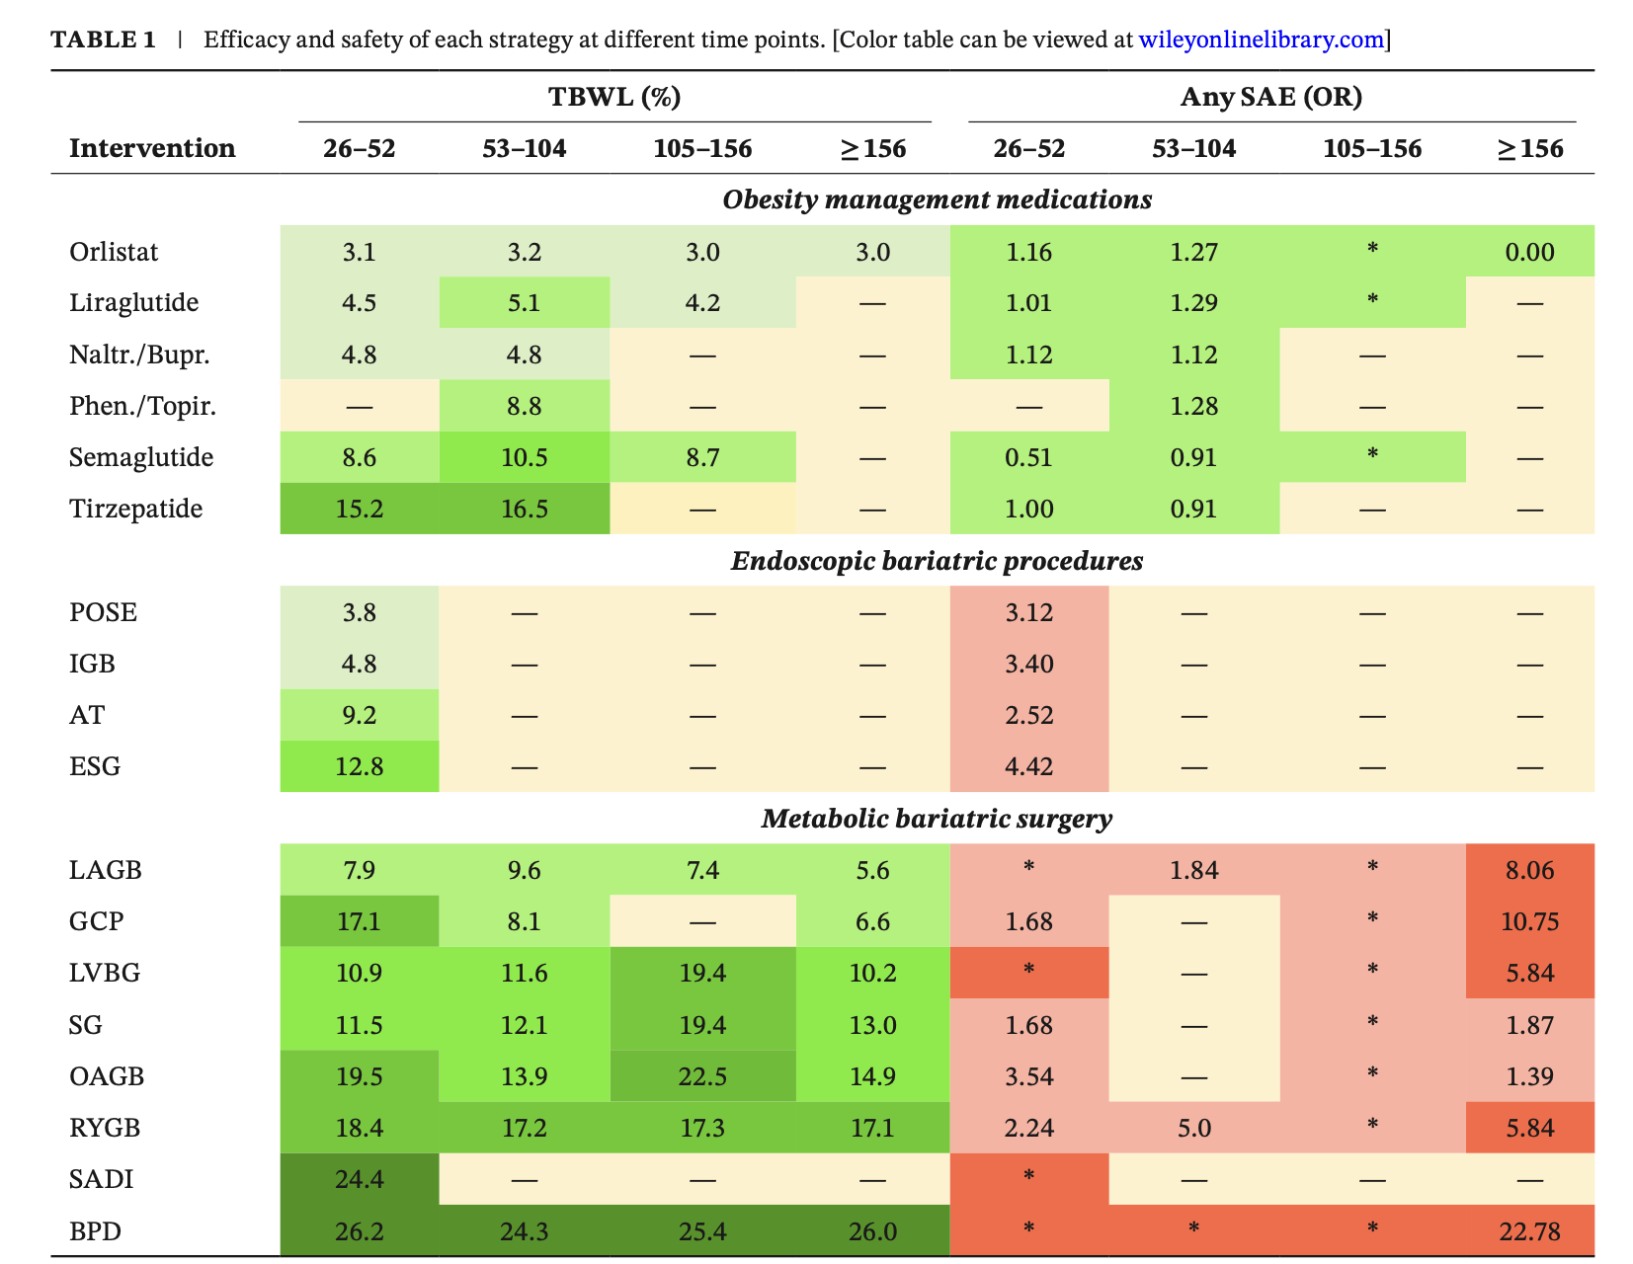
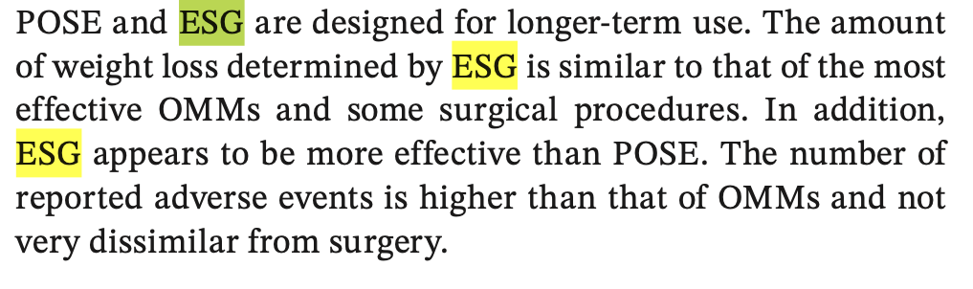
2025

Slide 14


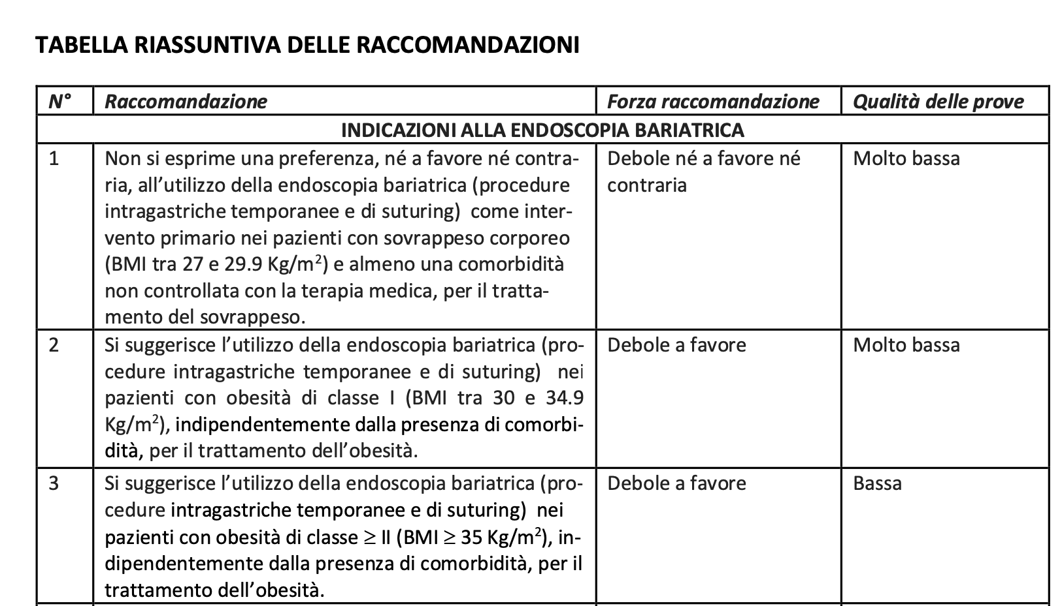
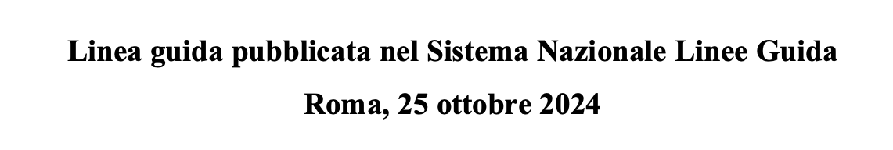
ITALIAN GUIDELINES - 2024

Slide 15
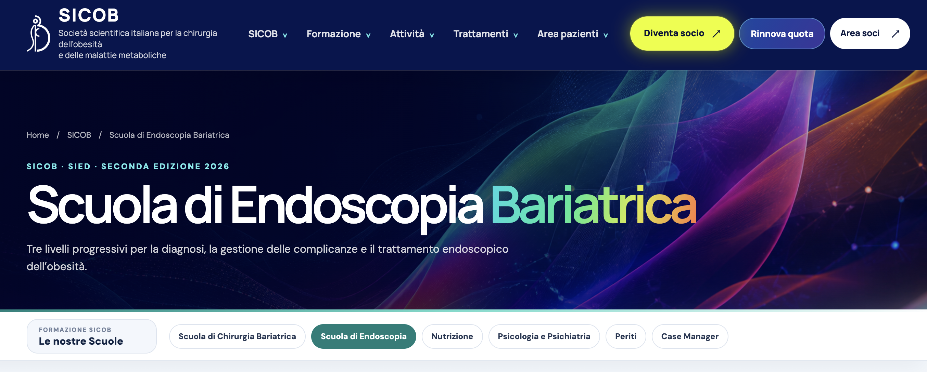
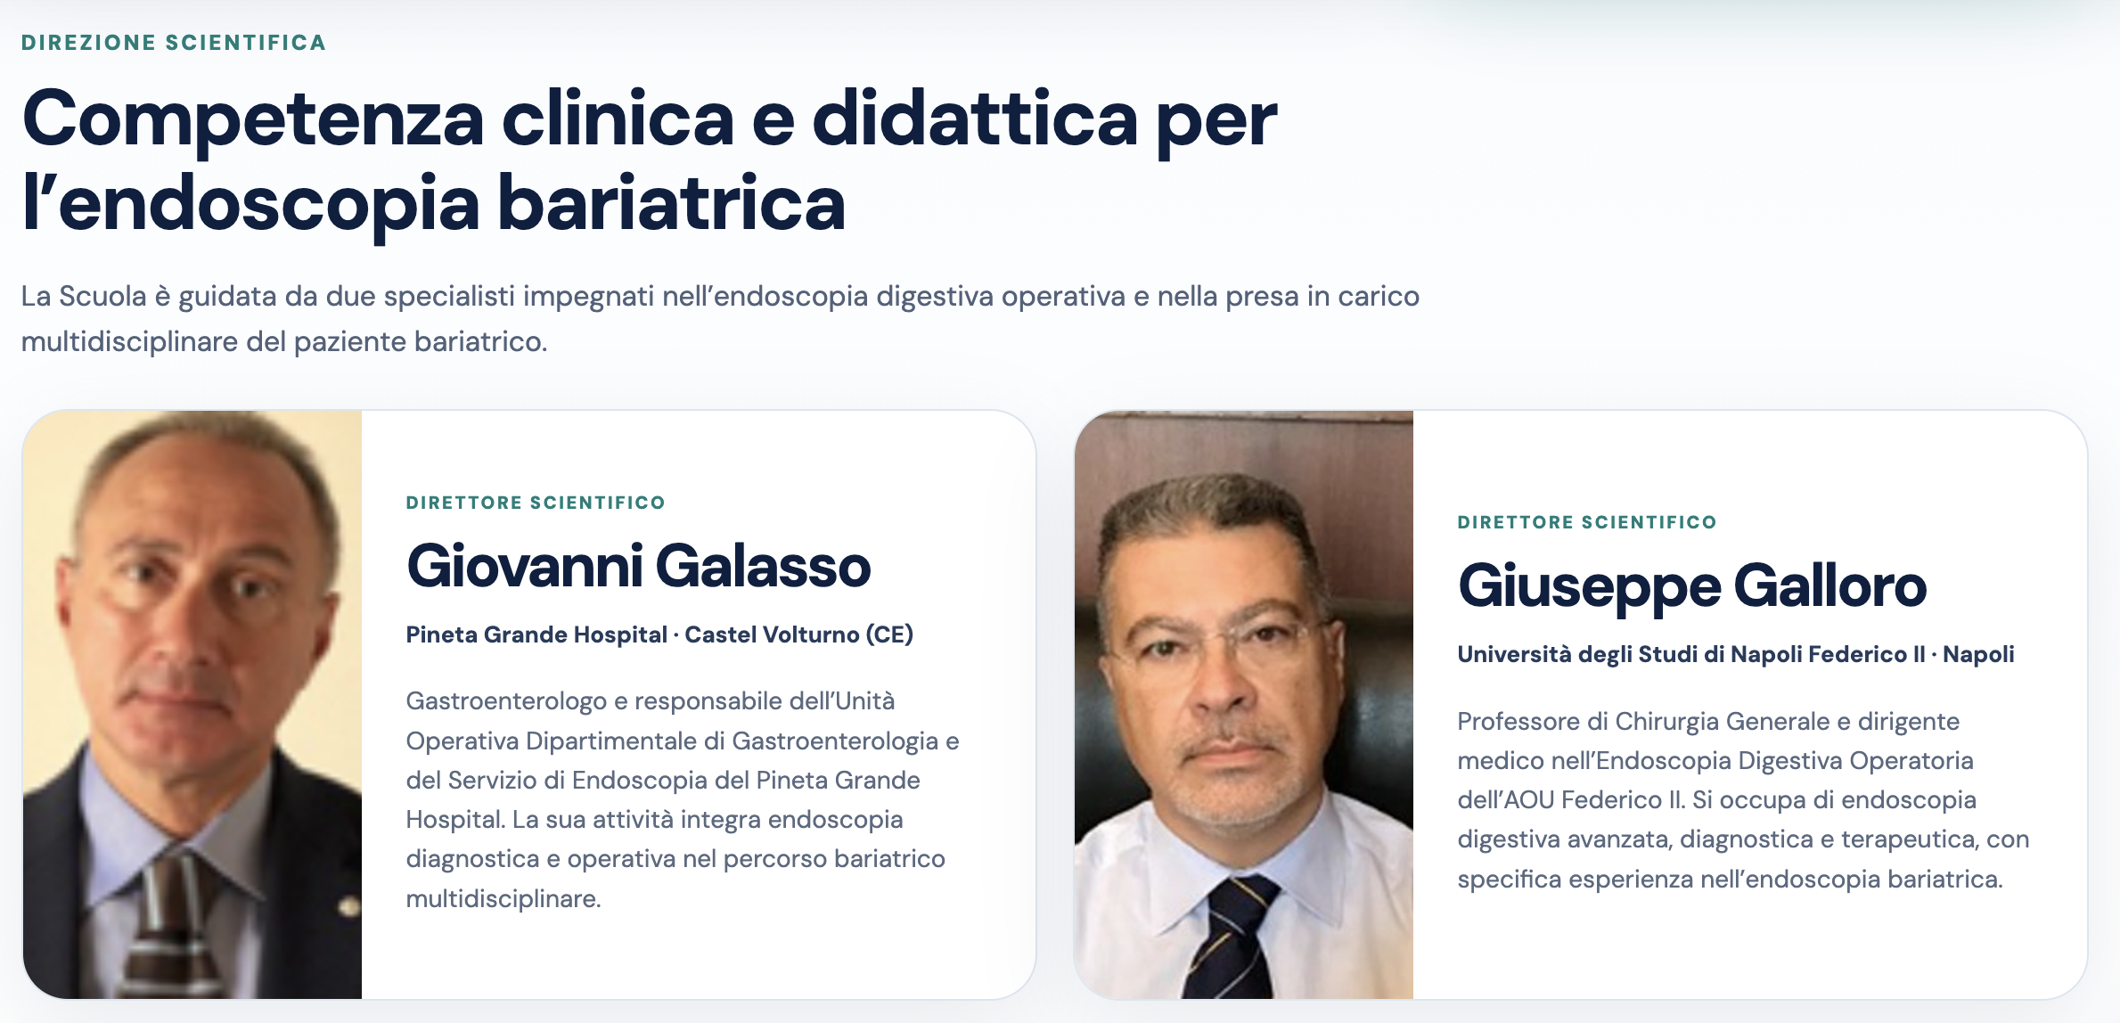
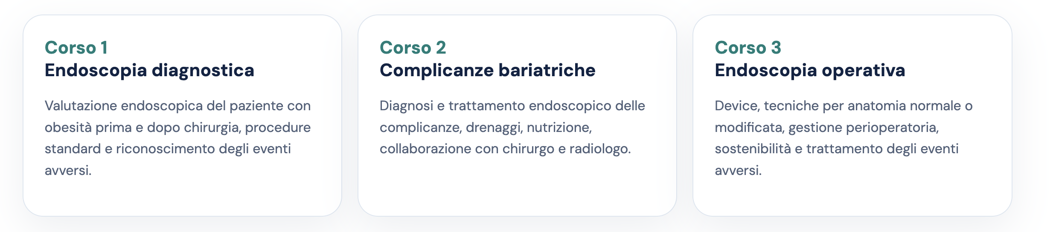

Slide 16

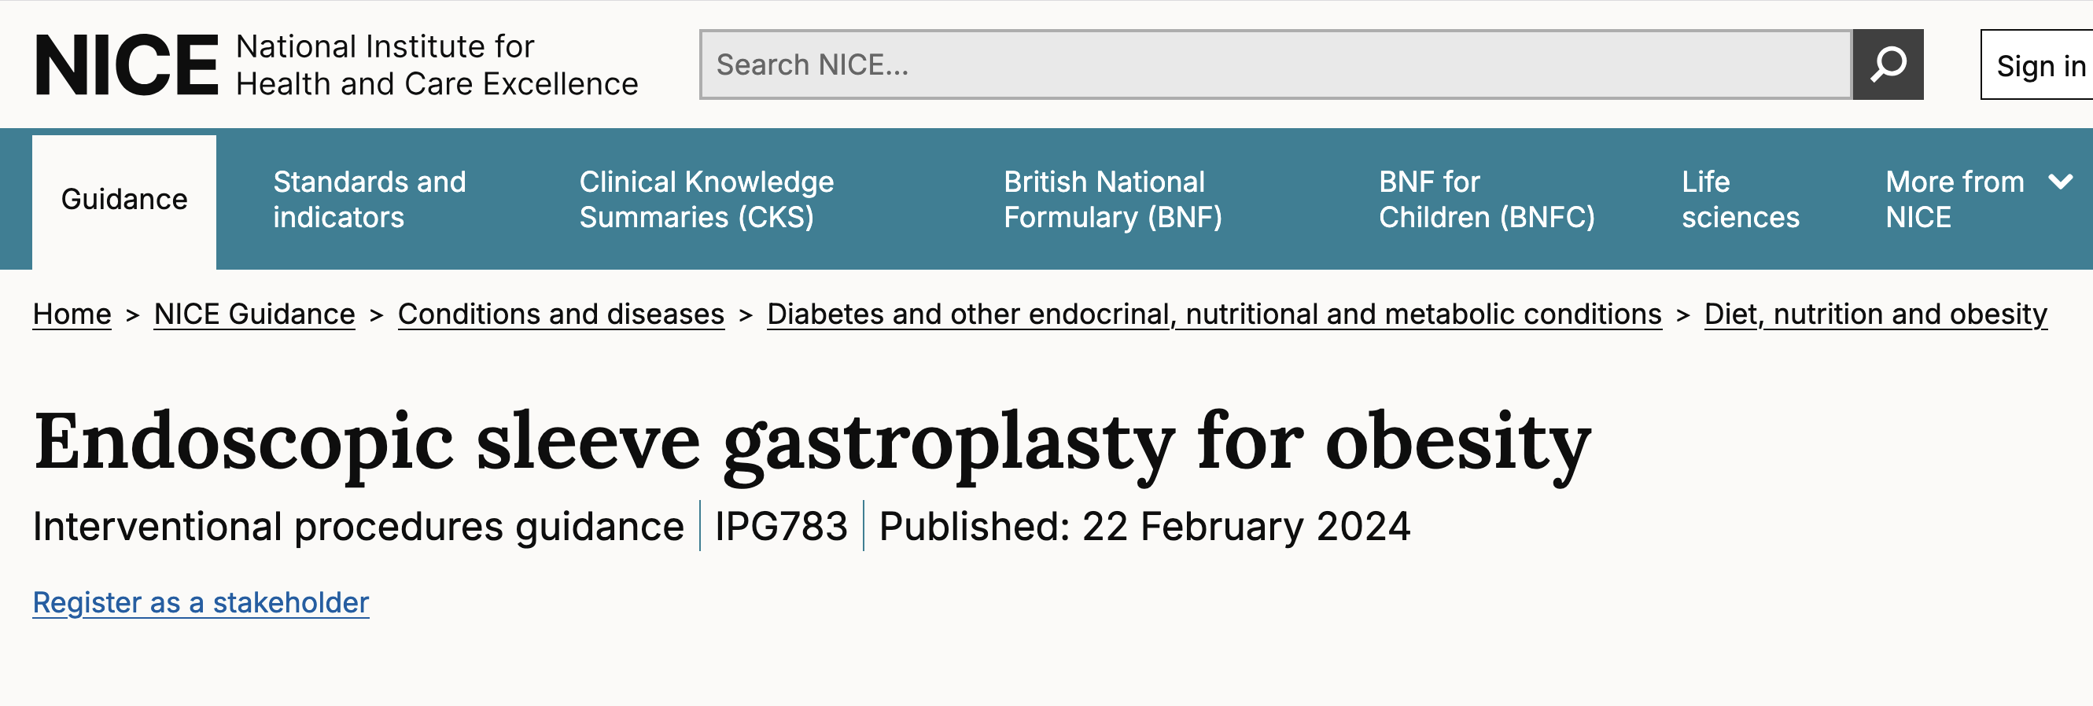
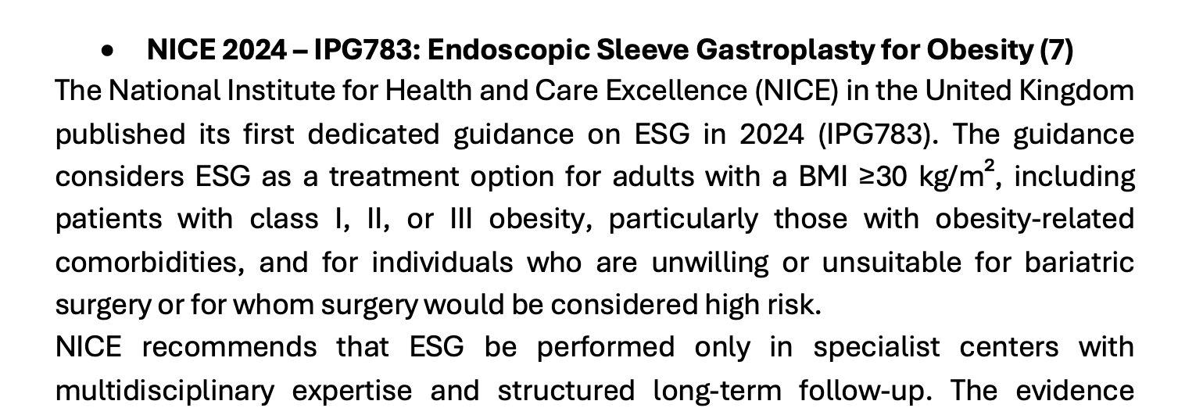
UK GUIDELINES - 2024

Slide 17


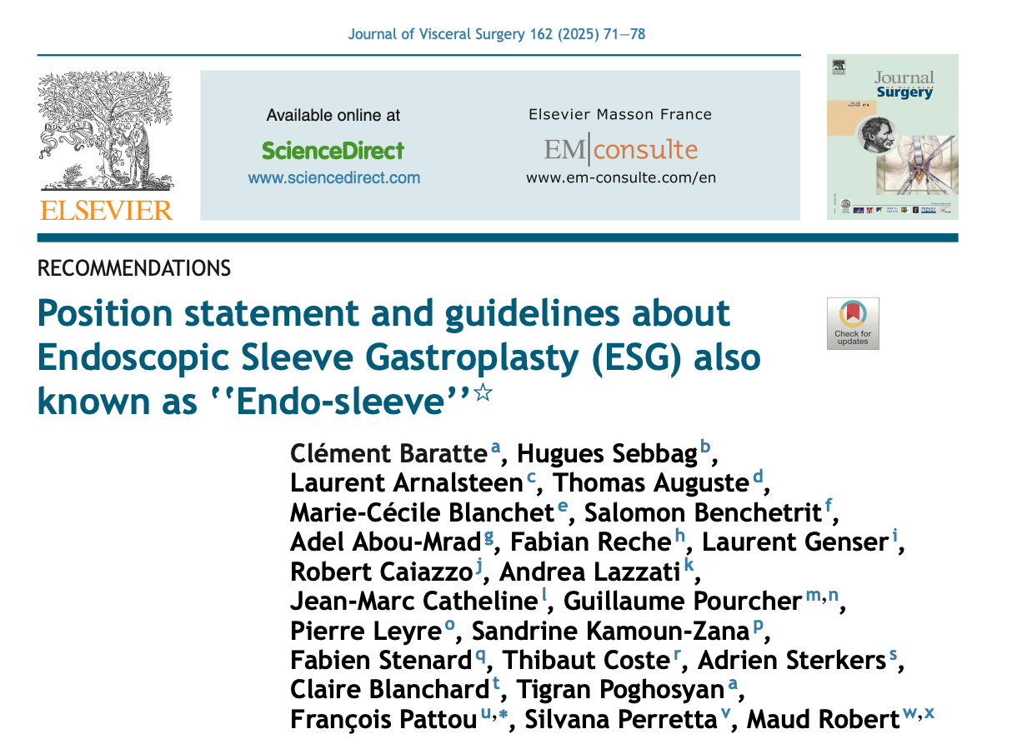
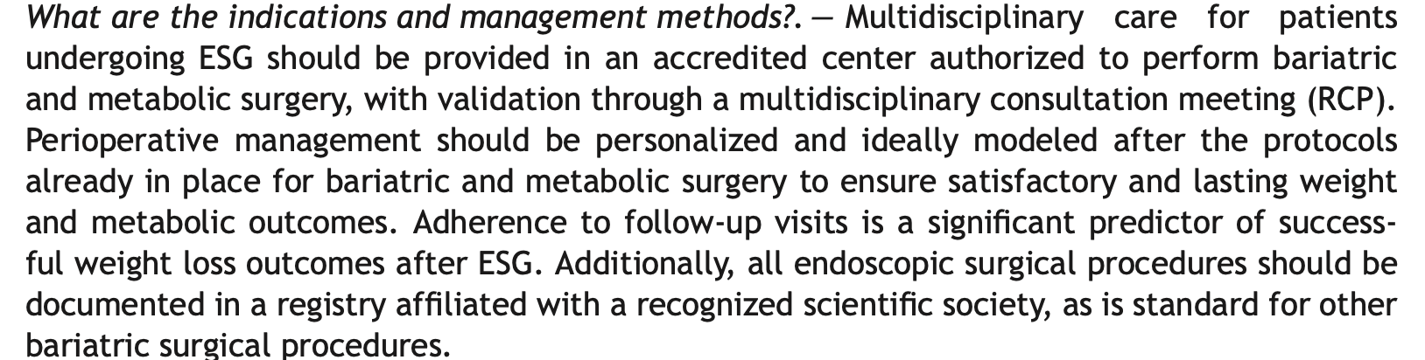
FRENCH GUIDELINES - 2025
ESG must be performed by a practitioner trained in endoscopy and obesity management, capable of ensuring thorough preoperative care and comprehensive postoperative follow-up, supported by an experienced multidisciplinary team.

Slide 18


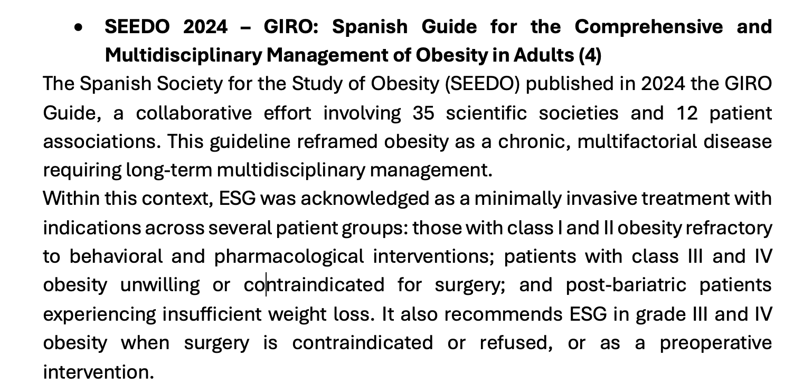
SPANISH GUIDELINES - 2025

Slide 19

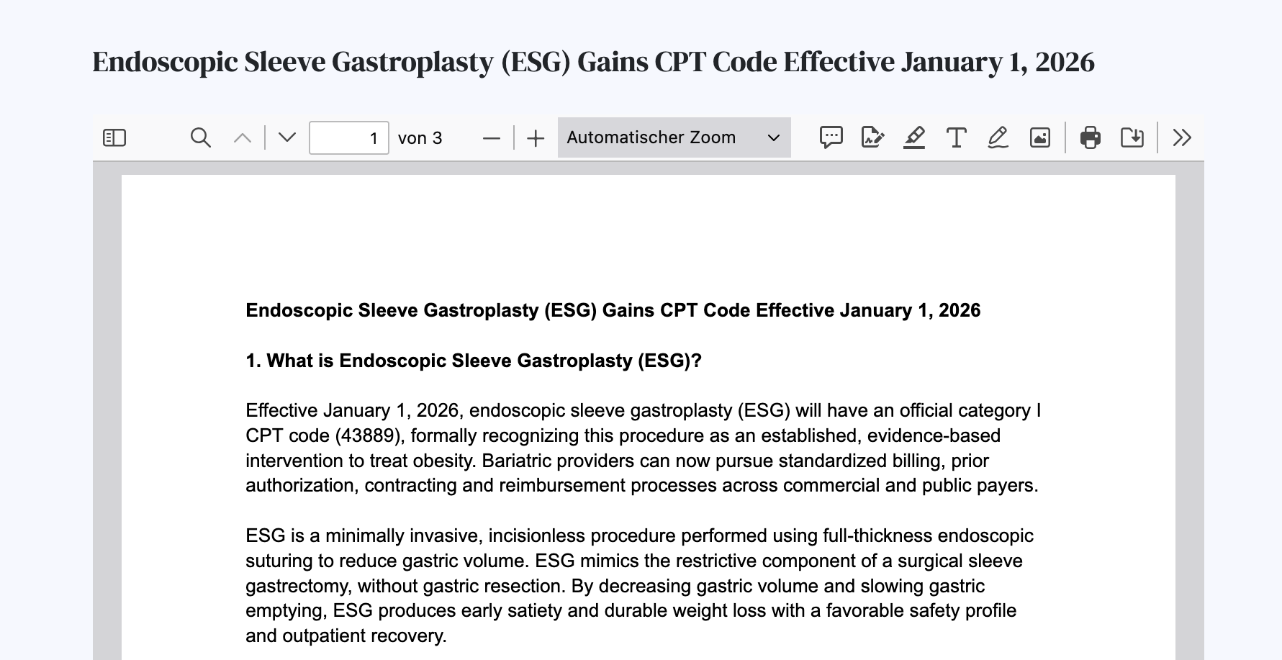
ASMBS GUIDELINES - 2026

Slide 20
REIMBURSEMENT
United Kingdom
NICE IPG783
Czech Republic
ESG reimbursement is secured
both through DRG codes (stomach plication)
and specific device codes
Germany
ESG is partially reimbursed through the DRG system
Italy
ESG is currently reimbursed only for inpatient stays longer than two days
Spain
revisional procedures are being approved on a case-by-case basis
France
joint dossier (“dossier concomitant”) launched in Q3 2025,
formal approval is unlikely before 2027
Belgium
ESG reimbursement is still under discussion

Slide 21


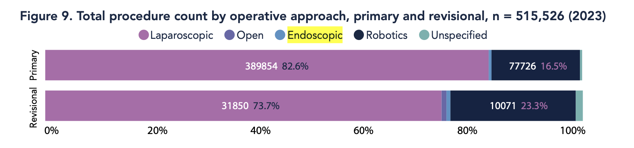
Endoscopic bariatric therapy is a rapidly evolving subspecialty
  Standardization
  Structured training
  Multidisciplinary collaboration
Credentialing
Mentorship
Networking
Need for quality assurance and professional sustainability
To avoid the risk of:
  Inconsistent training
  Variable outcomes
  Unregulated practice
2025 > 25.000 ESG procedures
Notes:
Demand - Three pillars for a great growth

Slide 22





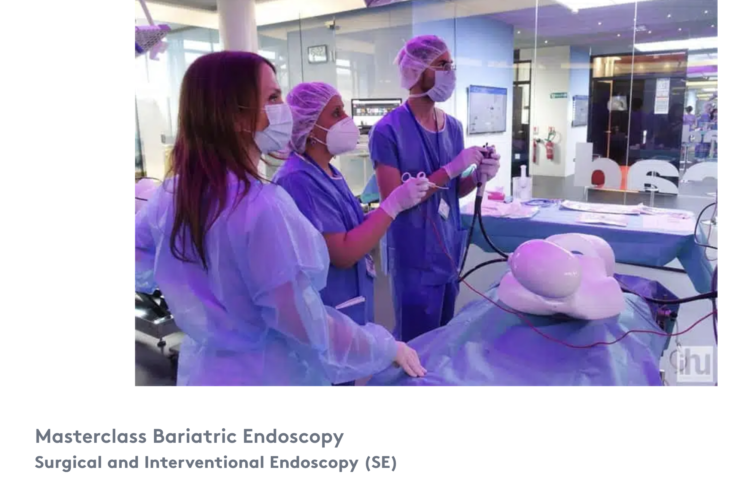
Credentialing
Credentialing ensures that practitioners are:
Adequately trained
Objectively assessed
Continuously monitored
Primary goals:
Patient safety
Procedural efficacy
Standardization across centers
Core specialty qualification (GI or Surgery)
Formal bariatric endoscopy training
Hands-on workshops and simulation
Supervised cases (proctorship)
Objective competency assessment
Ongoing CME and outcomes tracking

Slide 23
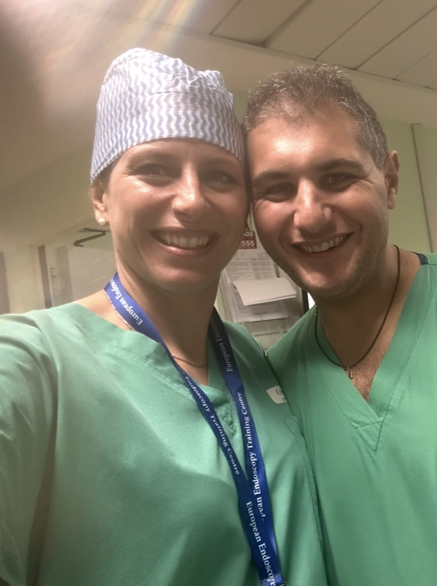
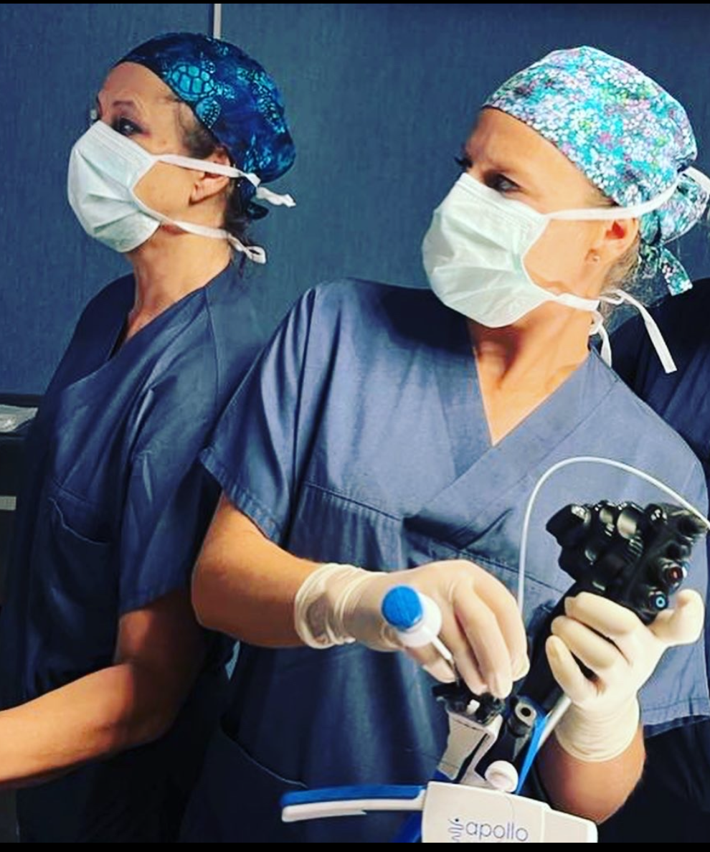
Mentorship
Mentorship bridges the gap between:
Training → Independent practice
Core components:
Procedural guidance
Patient selection
Complication management
Long-term follow-up strategies
Career and academic development

Slide 24

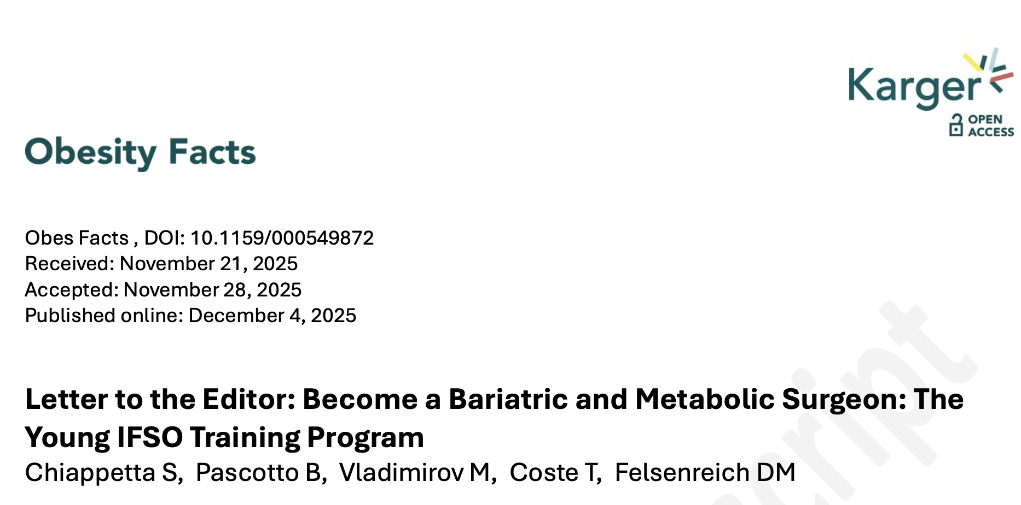


Networking: A Strategic Necessity
Networking enables:
Knowledge sharing
Multicenter research
Registry development
Rapid but safe innovation
Integration with obesity medicine teams

Slide 25
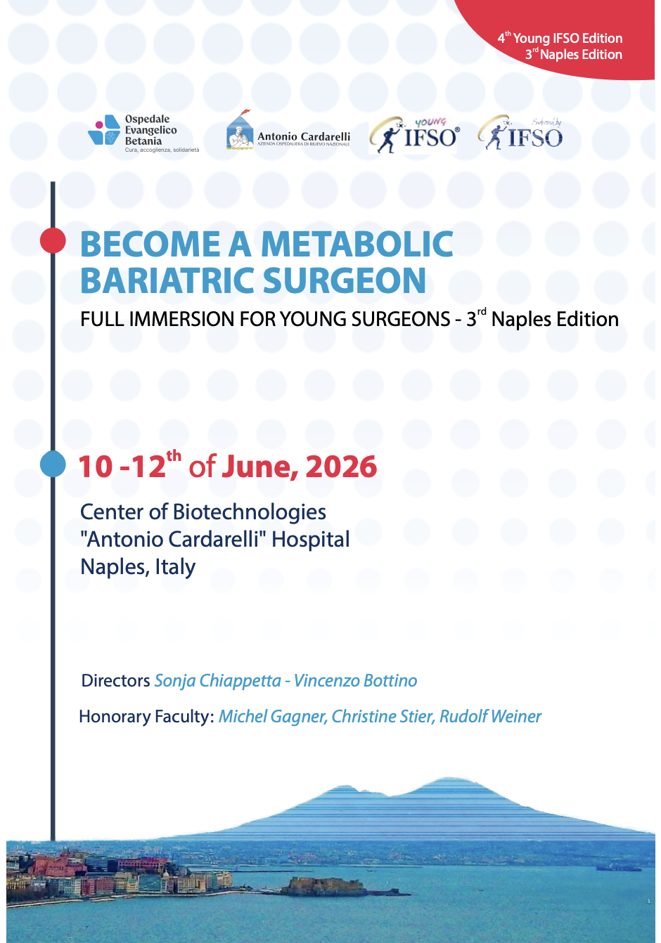



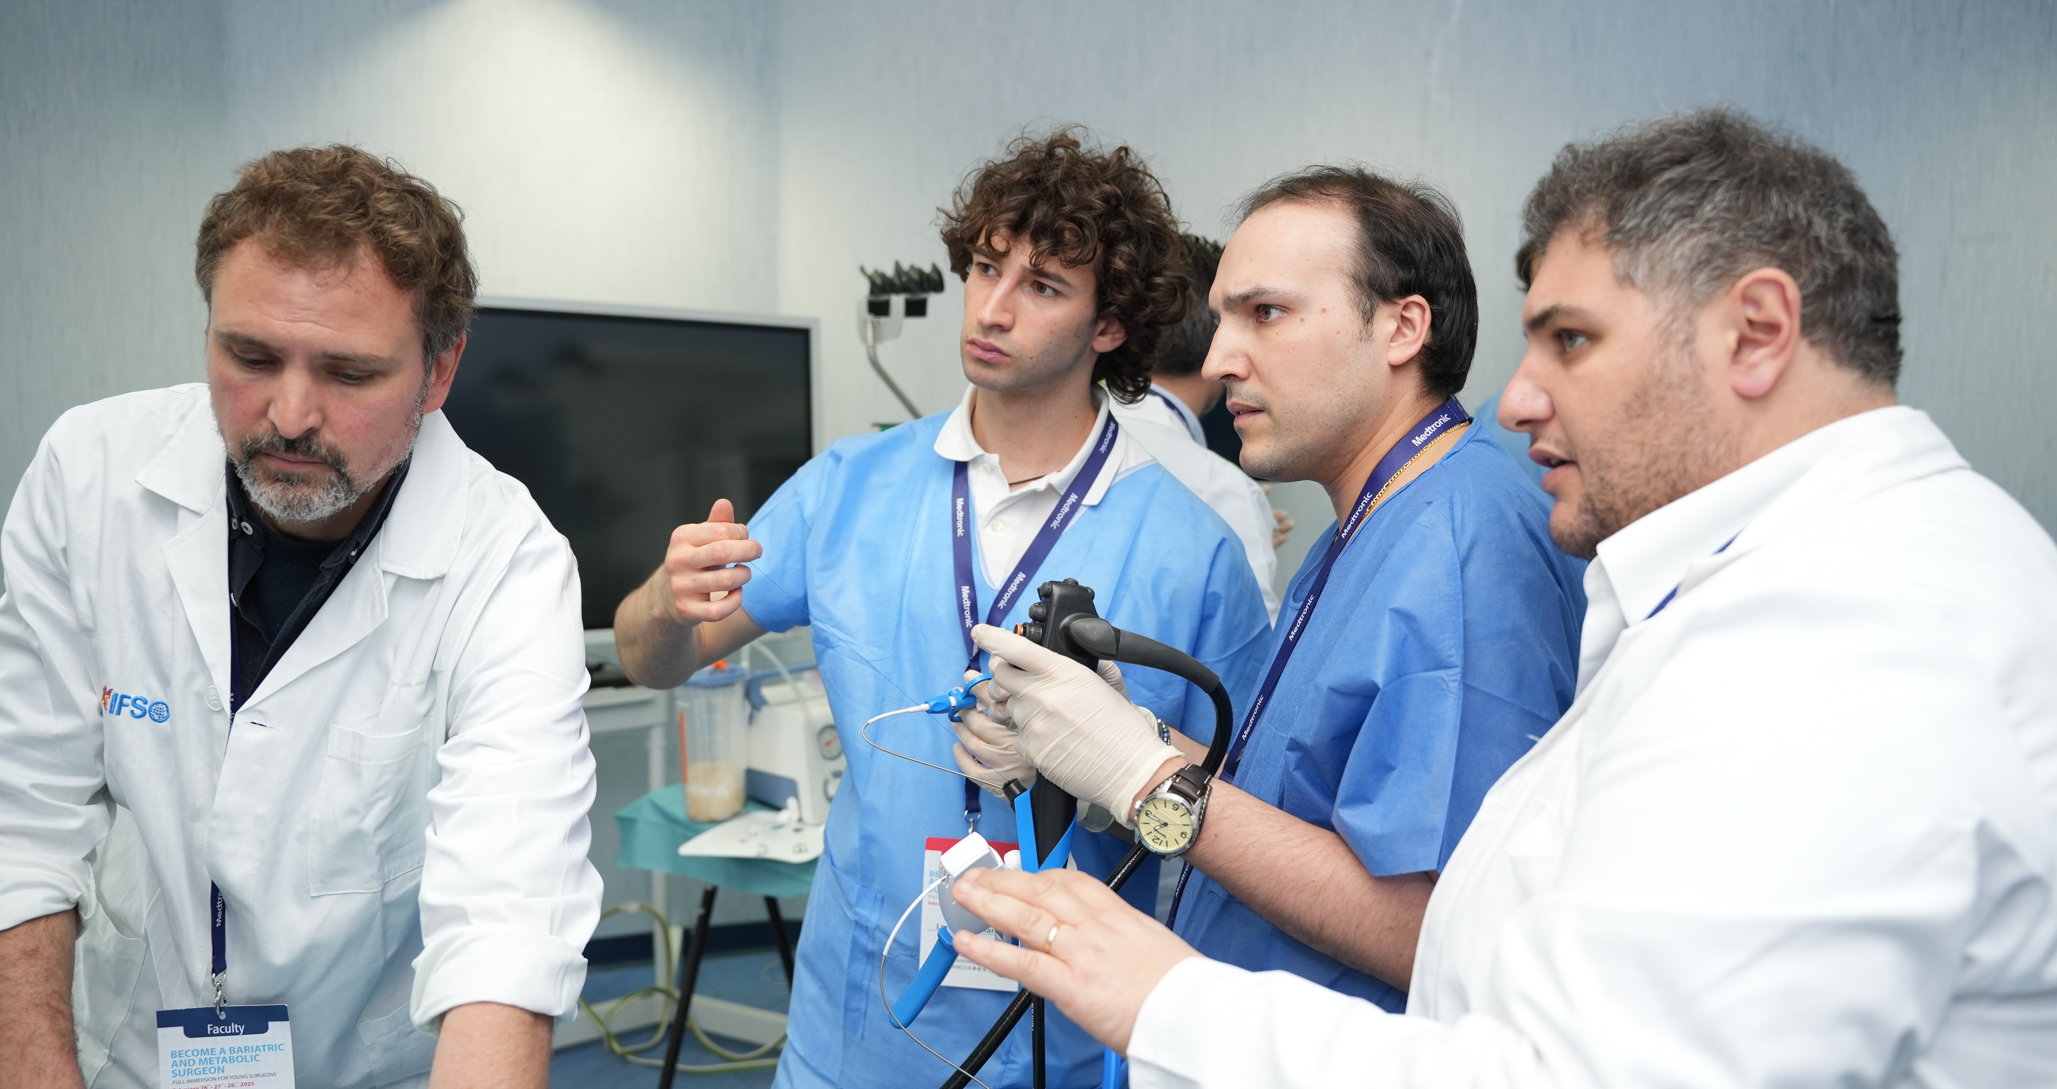


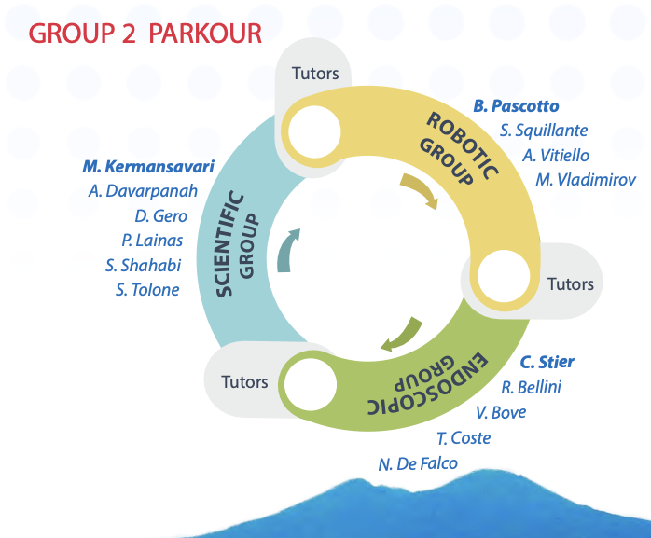
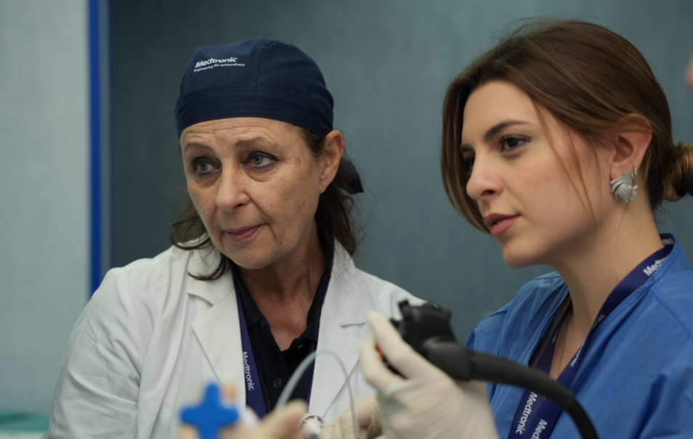
Where Networking Happens
International congresses and live courses
Society working groups
Multidisciplinary obesity programs
Digital professional platforms
Early-career engagement and global access

Slide 26





Education
EBT availabitlity: 52.2% - only 23.9% indepedently performed
IGB availability: 60.7%, only 34.6% indepedently performed
ESG availability: 26.4%, only 12.5 % indepedently performed
TORe availability: 19.2%, only 8.1 % indepedently performed
273 respondents from 49 countries

Slide 27



Education

Slide 28






Slide 29







Thank you
for your attention!
Sonja Chiappetta
drschiappetta@gmail.com
chiappetta.obesity.intouch
Sonja Chiappetta

